Slide 1
Web service project

Slide 2
Photo de groupe

Slide 3
Salim zemri

Slide 4
Charafein mohamed
Front design
Back site
Database connection
Mockup

Slide 5
Salim zemro
Front design
Back site
Database connection
Mockup

Slide 6
Kilian deroche
Front design
Back site
Database connection
Mockup

Slide 7


Web site structure

Slide 8
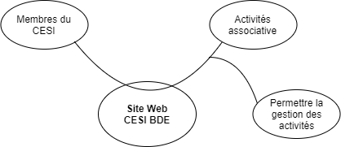
Functional analysise: APTE diagramme

Slide 9
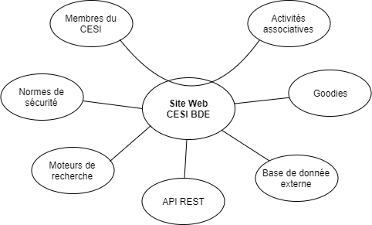
Functional analysise: actor diagramme

Slide 10
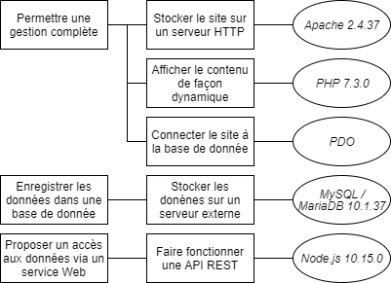
Technical choice: diagramme FAST

Slide 11
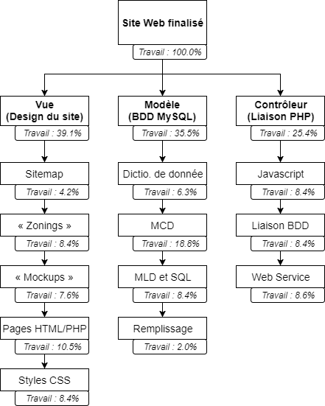
Task: wbs

Slide 12
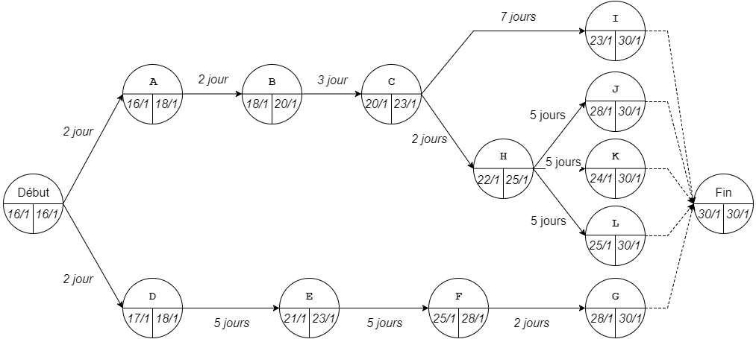
Task: pert

Slide 13
gant

Slide 14
The web pages

Slide 15
zoning

Slide 16
wireframe

Slide 17
mockup

Slide 18
Html 5

Slide 19
The steelsheets css

Slide 20
The data dictionnary

Slide 21
Conceptual merise graph

Slide 22
Database creation

Slide 23
The backend controller (script php)

Slide 24
PDO

Slide 25
JAVASCRIPT CONTROL (REGEX)

Slide 26
Rest api et node,js

Slide 27
Final preview

